Slide 1
Abstract Classes
static
© A+ Computer Science - www.apluscompsci.com
Lab 23

Slide 2
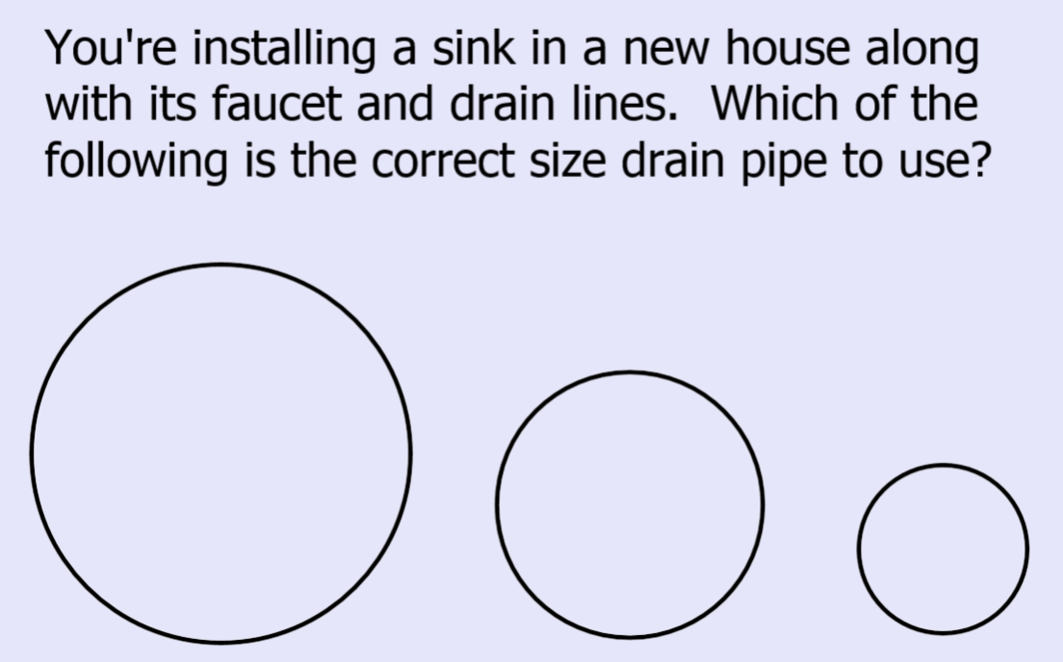

Slide 3
What are some things that programmers know, but most people don't?
Digital content can never be moved, only copied.
You can never watch or listen to anything on the internet without having it copied to your computer first.
You cannot password protect a computer from someone who has physical access to it, only encryption works.
When you empty the trashcan, the files are not deleted.
When you format your hard drive, the files are not deleted.
Murphy was right.
Your desktop computer can run advanced programs for free that used to be available only to big companies for $100,000. Like Unix, virtual machines and SQL servers.
The Cloud simply means someone else's computer.
That Office documents are actually ZIP files.
© A+ Computer Science - www.apluscompsci.com

Slide 4
Abstract Classes
Polymorphism
© A+ Computer Science - www.apluscompsci.com

Slide 5
Abstract Classes
Abstract classes are used as a starting point for new classes.
No free-standing objects can be
instantiated from an abstract class, but every subclass object has a superclass object at its core.
© A+ Computer Science - www.apluscompsci.com
Notes:
Abstract Classes are used to create hierarchies of classes. Abstract classes are used to setup future classes.
An abstract class can not be instantiated.

Slide 6
Abstract Classes
Abstract methods:
public interface Comparable {
public int compareTo(Object obj);
}
© A+ Computer Science - www.apluscompsci.com
Notes:
Abstract Classes are used to create hierarchies of classes. Abstract classes are used to setup future classes.
An abstract class can not be instantiated.

Slide 7
Real Abstract Class
Mammal (abstract class)
Human
Whale
Cow
© A+ Computer Science - www.apluscompsci.com
Notes:
In this example, Mammal is the abstract class. You would never have just a Mammal. For instance, you would not walk outside and go “Hey, look at that Mammal!” Mammal would be used to create something more specific, like a Dog, Human, or Whale.

Slide 8
Abstract Classes
Any sub class that extends a
super abstract class must
implement all abstract methods in the super class (or be declared abstract itself).
© A+ Computer Science - www.apluscompsci.com
Notes:
All abstract methods in the Abstract class must be implemented by the sub class extending the abstract class.
This process is very similar to implementing an interface. When implementing an interface, all abstract methods in the interface must be implemented in the class. All methods in an interface are Abstract.

Slide 9
public abstract class Monster{
private String myName;
public Monster() {
myName ="";
}
public Monster(String name) {
myName =name;
}
public String getName() {
return myName;
}
public abstract void talk( );
public String toString() {
return myName + "\n";
}
}
Abstract
Class
© A+ Computer Science - www.apluscompsci.com
Notes:
Monster is an abstract class.
Monster x = new Monster(); //illegal
Monster y = new Ghost(); //legal
Monster cannot be instantiated.
Monster contains one abstract method, method talk();
The assumption is that all Monsters will have a name and name related methods. Also, it is assumed that all Monsters will talk. There is no way to know at the Monster level what exactly a particular type of Monster will say. The talk() method is abstract because it makes no sense it implement talk() at the Monster level. It makes more sense to write talk() for each specific Monster as each specific Monster will say something specific.

Slide 10
Abstract Classes
Why define talk as abstract?
public abstract void talk( );
Does each Monster say
the exact same thing?
© A+ Computer Science - www.apluscompsci.com
Notes:
Each Monster will say something specific. A Ghost will say something different than a Werewolf and a Yetti will say something different from a Vampire.
Thus, the talk() method is abstract as it will be written in each of the specific Monsters in a way specific to each Monster.

Slide 11
Vampire
Sub Class
class Vampire extends Monster
{
public Vampire( String name ) {
super(name);
}
public void talk()
{
out.println("Vampire " + getName() +
" say \"I want to drink your blood!\"");
}
}
© A+ Computer Science - www.apluscompsci.com
Notes:
Vampire is a Monster, but it is a Monster that talks in its own specific way.
A Vampire says “I want to drink your blood!”.

Slide 12
Ghost
Sub Class
class Ghost extends Monster
{
public Ghost( String name )
{
super(name);
}
public void talk()
{
out.println("Ghost " + getName()
+ " say \"Where did I go?\"\n\n");
}
}
© A+ Computer Science - www.apluscompsci.com
Notes:
Ghost is a Monster, but it is a Monster that talks in its own specific way.
A Ghost says “Where did I go?”.

Slide 13
Witch
Sub Class
class Witch extends Monster
{
public Witch( String name )
{
super(name);
}
public void talk()
{
out.println("Witch "+getName()+
+ " say \"I like to fly on broom!\"\n\n");
}
}
© A+ Computer Science - www.apluscompsci.com
Notes:
Ghost is a Monster, but it is a Monster that talks in its own specific way.
A Ghost says “Where did I go?”.

Slide 14
Abstract Classes
Monster (abstract class)
Vampire
Ghost
Witch
© A+ Computer Science - www.apluscompsci.com
Notes:
In this example, Monster is the abstract class. You would never have just a Monster. Monster would be used to create something more specific.
A Vampire is a specific type of Monster.
A Ghost is a specific type of Monster.
A Witch is a specific type of Monster.
A Skeleton is a specific type of Monster.
A Sasquatch is a specific type of Monster.
A Student is a specific type of Monster.

Slide 15
Abstract Classes
Abstract classes usually have some methods declared abstract, but you can declare a class abstract even if it has all concrete methods. You would do so to prevent instantiation.
© A+ Computer Science - www.apluscompsci.com
Notes:
Abstract Classes are used to create hierarchies of classes. Abstract classes are used to setup future classes.
An abstract class can not be instantiated.

Slide 16
Polymorphism
Polymorphism - the ability of one
general thing to behave like other
specific things.
© A+ Computer Science - www.apluscompsci.com

Slide 17
Polymorphism
//instance variable
Monster[] monsters;
//ask for the number of monsters
//get the number of monsters
monsters = new Monster[size];
for ( int j=0; j < monsters.length; j++ )
{
int r = (int)(Math.random() * 3);
if(r == 0)
monsters[j] = new Vampire(kb.nextLine());
else if(r == 1)
monsters[j] = new Witch(kb.nextLine());
else
monsters[j] = new Ghost(kb.nextLine());
}
© A+ Computer Science - www.apluscompsci.com
Notes:
In this section of code, random Monsters are loaded into the monsters array. Monsters is an array of Monster references. Monsters can refer to any type of Monster. Vampire, Witch, and Ghost extend Monster; thus, they are Monster Objects.

Slide 18
Polymorphism
Which involves polymorphism?
public void monstersTalk( )
{
for ( Monster m : monsters)
m.talk();
}
public void printMonsters( )
{
for ( Monster m : monsters)
out.println(m);
}
© A+ Computer Science - www.apluscompsci.com
Notes:
The monstersTalk() method will make each Monster talk. Java does not need to know which type of Monster each reference refers to. Java knows that each reference is a Monster and that Monster has a talk() method. Java will dynamically call the appropriate Monster talk() for each Monster at run-time. This is a very good example of dynamic binding.

Slide 19
Static Binding (Early Binding)
Method calls that are locked down at compile time.
public void printMonsters( )
{
for ( Monster m : monsters)
out.println(m.toString());
}
© A+ Computer Science - www.apluscompsci.com
Notes:
Static binding is basically just matching up a class with its list of methods at compile time. Java makes sure that class x has method y.
Dynamic binding occurs dynamically at run-time. Java will call the appropriate method for a particular class on the fly. The same line of code will be used to call each different Objects method. The method names are the same, but the Objects will differ.

Slide 20
Dynamic Binding (Late Binding)
Method calls that are set during run-time.
public void monstersTalk( )
{
for ( Monster m : monsters)
m.talk();
}
© A+ Computer Science - www.apluscompsci.com
Notes:
Static binding is basically just matching up a class with its list of methods at compile time. Java makes sure that class x has method y.
Dynamic binding occurs dynamically at run-time. Java will call the appropriate method for a particular class on the fly. The same line of code will be used to call each different Objects method. The method names are the same, but the Objects will differ.

Slide 21
Static Binding (Early Binding)
Method calls that are locked down at compile time.
public void monstersTalk( )
{
for ( Vampire v : monsters)
v.talk();
}
© A+ Computer Science - www.apluscompsci.com
Notes:
Static binding is basically just matching up a class with its list of methods at compile time. Java makes sure that class x has method y.
Dynamic binding occurs dynamically at run-time. Java will call the appropriate method for a particular class on the fly. The same line of code will be used to call each different Objects method. The method names are the same, but the Objects will differ.

Slide 22
Types of Binding
Which won’t compile, assuming bark() is only defined in the Dog class, but run() is defined in both Animal and Dog?
Animal a = new Dog(); a.bark(); ((Dog)a).bark(); a.run();
© A+ Computer Science - www.apluscompsci.com
Notes:
This is static binding because only the Dog class will have a bark() method, so the method choice is locked down at compile time.

Slide 23
Types of Binding
Now, which kind of binding does each line represent?
Animal a = new Dog(); a.bark(); //error - Animal has no bark ((Dog)a).bark(); //needs a cast
a.run();
© A+ Computer Science - www.apluscompsci.com
Notes:
This is static binding because only the Dog class will have a bark() method, so the method choice is locked down at compile time.

Slide 24
Types of Binding
Now, which kind of binding does each line represent?
Animal a = new Dog(); a.bark(); //error - Animal has no bark
((Dog)a).bark(); ← Static binding
a.run(); ← Dynamic binding
© A+ Computer Science - www.apluscompsci.com
Notes:
This is static binding because only the Dog class will have a bark() method, so the method choice is locked down at compile time.

Slide 25
Number
<abstract>
Integer
Double
Short
Byte

Slide 26
Ways to instantiate an Integer object in order of preference:
Let autoboxing do its job:
Integer num = 10;
Only necessary if you need to ensure you’re creating an Integer object:
char c = 65; Integer num = Integer.valueOf(c);
The public constructor has been deprecated and marked for removal:
Integer num = new Integer(10);
Notes:
In the second case the object instantiated would be a Character object.

Slide 27
Which of the following would compile?
Integer num = 10;
double num = 10;
Double num = 10;
Number num = 10;
I only
II only
I and II
I and III
I, II, and IV

Slide 28
Which of the following would compile?
Integer num = 10;
double num = 10;
Double num = 10;
Number num = 10;
III would not compile because an Integer object would be created. These would both compile:
Double num = 10.0;
Double num = Double.valueOf(10);

Slide 29
add(spot, Obj)
add(Obj)
set(spot, Obj)
remove(spot)
remove(Obj);
get(spot);
isEmpty();
clear();
List
<interface>
ArrayList
LinkedList
Stack
Vector
All of the classes that implement the List interface must have all of the listed methods implemented

Slide 30
List<Double> list;
list = new ArrayList<Double>();
double d = 3.5;
int i = 4;
Given the code segment above, which of the following are valid statements?
list.add(Double.valueOf( d ));
list.add(d);
list.add(Integer.valueOf( i ));
list.add(i);

Slide 31
List<Double> list;
list = new ArrayList<Double>();
double d = 3.5;
int i = 4;
Given the code segment above, which of the following are valid statements?
list.add(Double.valueOf( d ));
list.add(d);
list.add(Integer.valueOf( i ));
list.add(i);

Slide 32
List<Number> list;
list = new ArrayList<Number>();
double d = 3.5;
int i = 4;
Given the code segment above, which of the following are valid statements?
list.add(Double.valueOf( d ));
list.add(d);
list.add(Integer.valueOf( i ));
list.add(i);

Slide 33
Extends / Implements
RULES
Classes extend Classes
Interfaces extend Interfaces
Classes implement Interfaces
© A+ Computer Science - www.apluscompsci.com
Notes:
A class can extend another class.
An abstract class can extend another abstract class.
A class can extend an abstract class.
An abstract class can extend a class.
An interface can extend another interface.
A class can implement an interface.
An abstract class can implement an interface.

Slide 34
Extends / Implements
RULES
Classes can extend ONE Class
ClassA extends ClassB
ClassA extends ClassB , ClassC
Notes:
A class can extend another class.
An abstract class can extend another abstract class.
A class can extend an abstract class.
An abstract class can extend a class.
An interface can extend another interface.
A class can implement an interface.
An abstract class can implement an interface.

Slide 35
Extends / Implements
RULES
Classes can implement MULTIPLE Interfaces
ClassA implements InterfaceA, InterfaceB, ...
Interfaces can extend MULTIPLE Interfaces
InterfaceA extends InterfaceB, InterfaceC, ...
Notes:
A class can extend another class.
An abstract class can extend another abstract class.
A class can extend an abstract class.
An abstract class can extend a class.
An interface can extend another interface.
A class can implement an interface.
An abstract class can implement an interface.

